Slide 1
Documentary
-> Feminism
By: Tamara Tardová

Slide 2
Table of contents
1
4
Learning goal
Process
2
5
Inspiration for project
Biggest challenges
3
6
Product goal
How successful was it

Slide 3
Learning goal
1
Negative connotation
3
To research & understand how feminism gained a negative connotation throughout the movement’s history
Young people
To research & to understand how young people view feminism nowadays

Slide 4
Inspiration for this project
A
Sports standards for boys VS girls
B
My experience of being afraid to call myself a feminist
C
Discussions on this topic between my friends
D
Curiosity to find out more about feminism

Slide 5
Product goal
Take my audience on an informational journey through the history of feminism
so that they understand how feminism gained a negative connotation and how young people view it nowadays

Slide 6
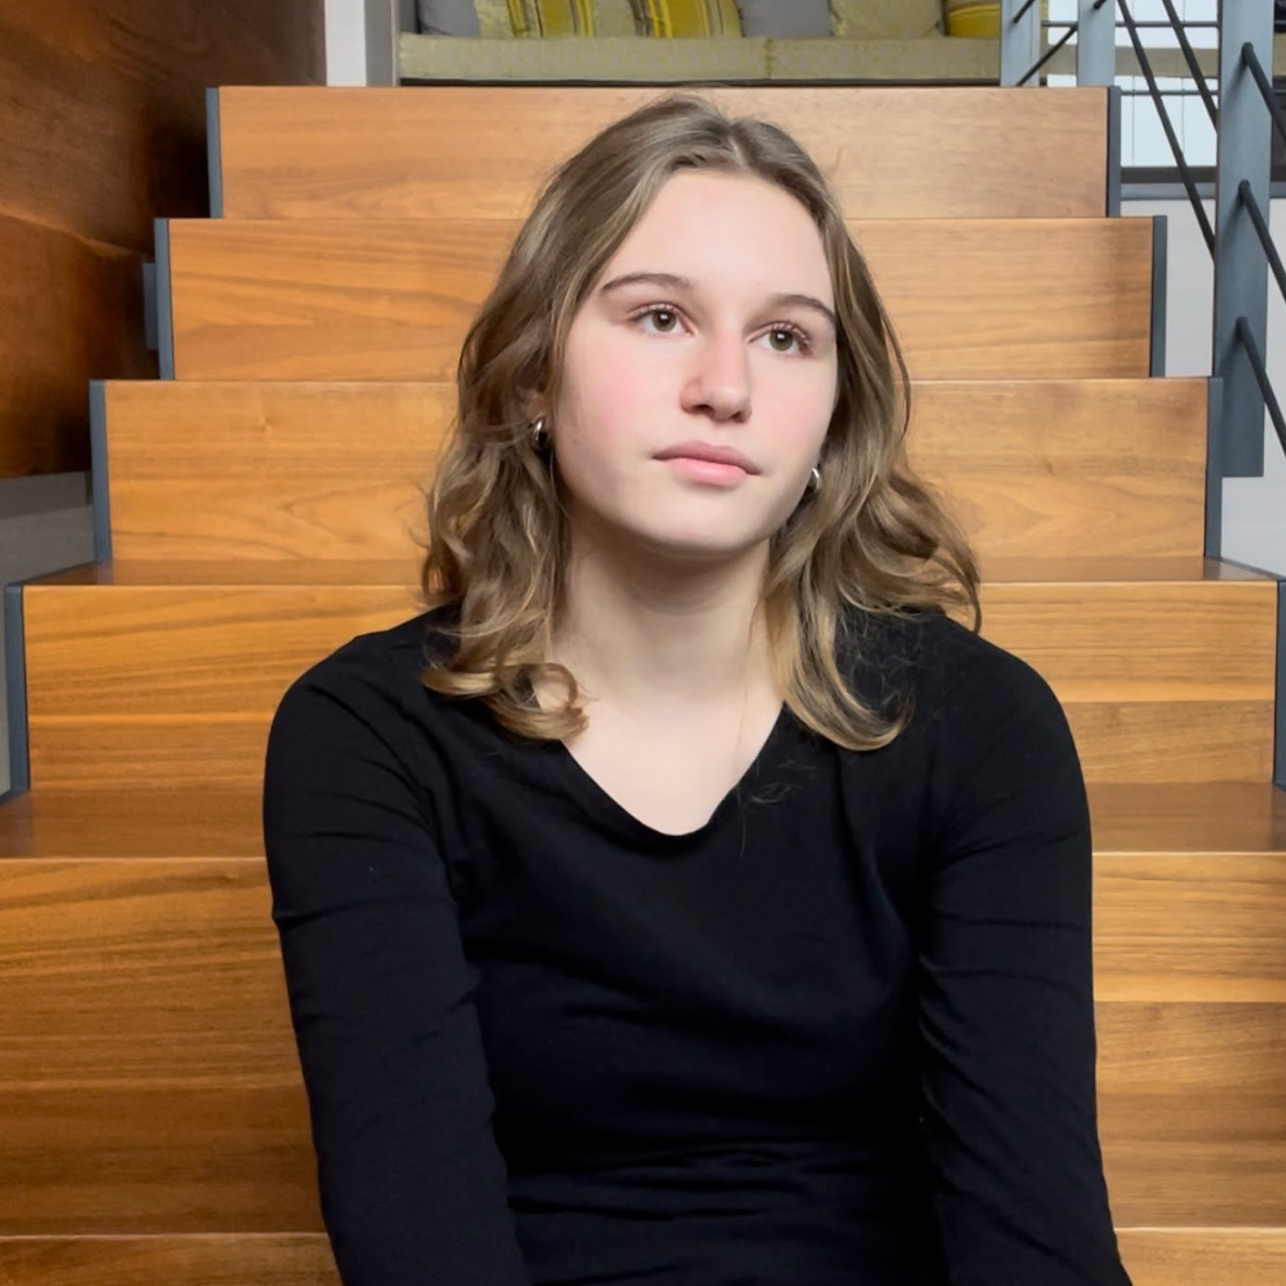
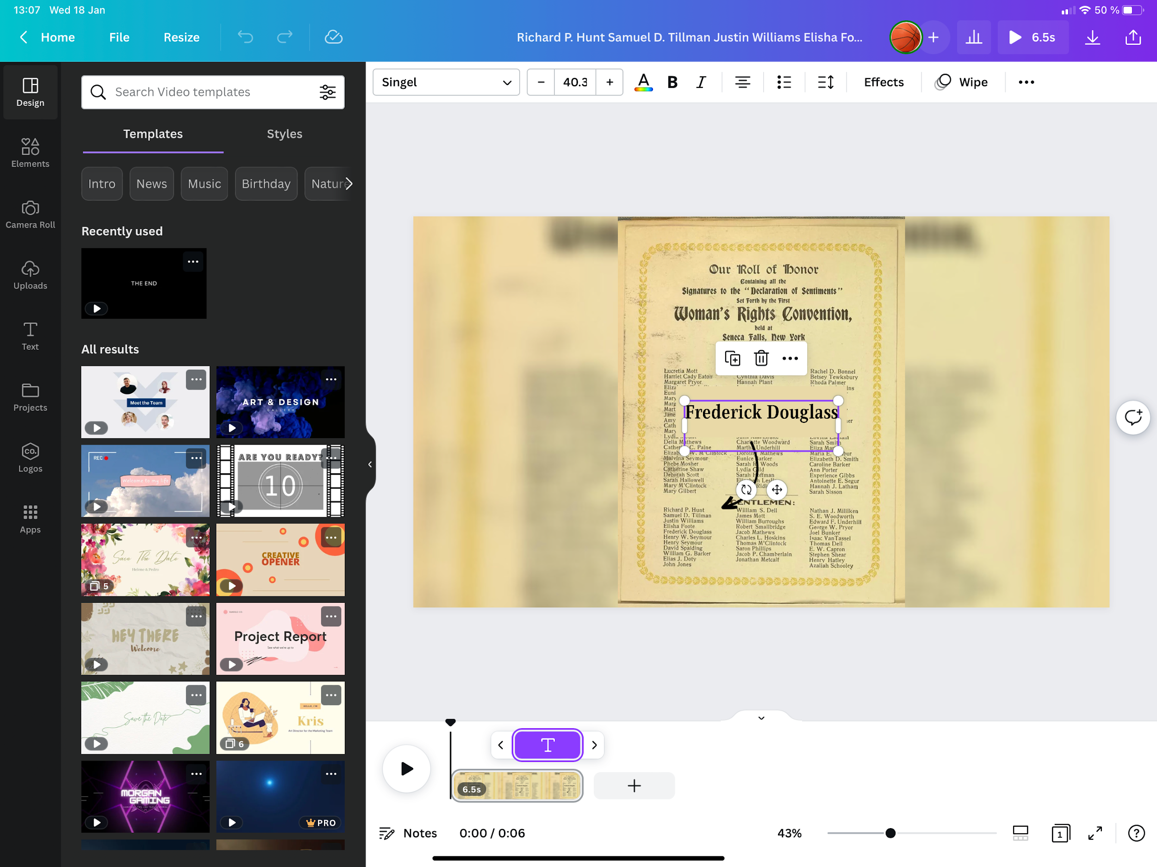
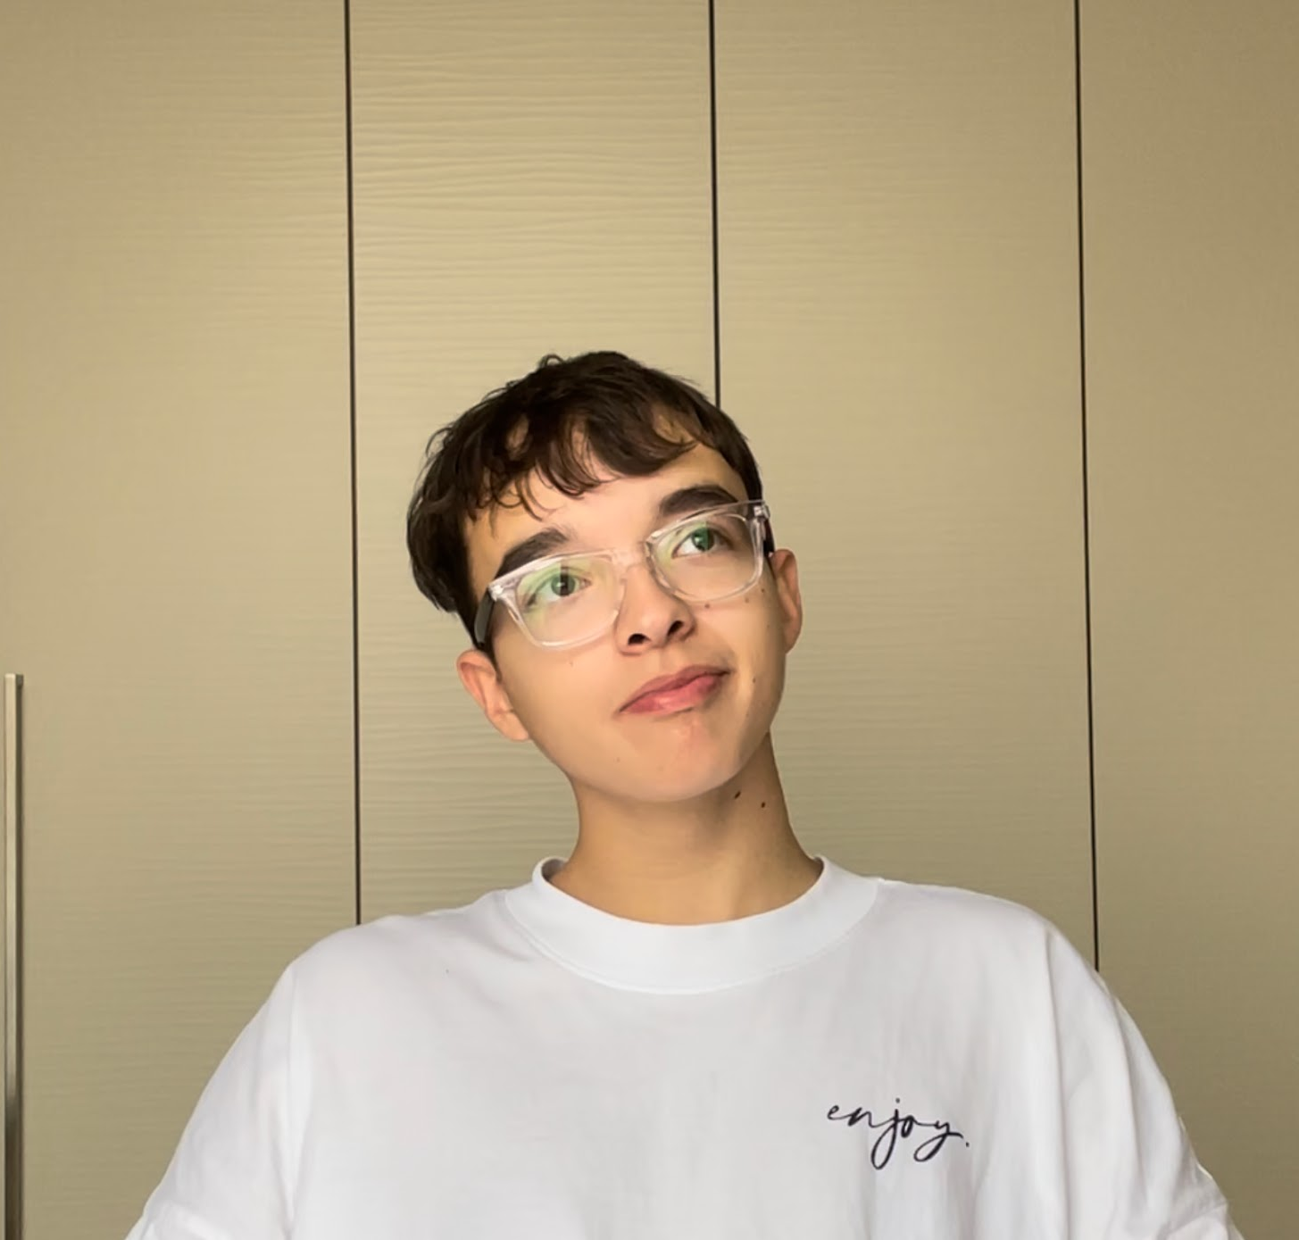
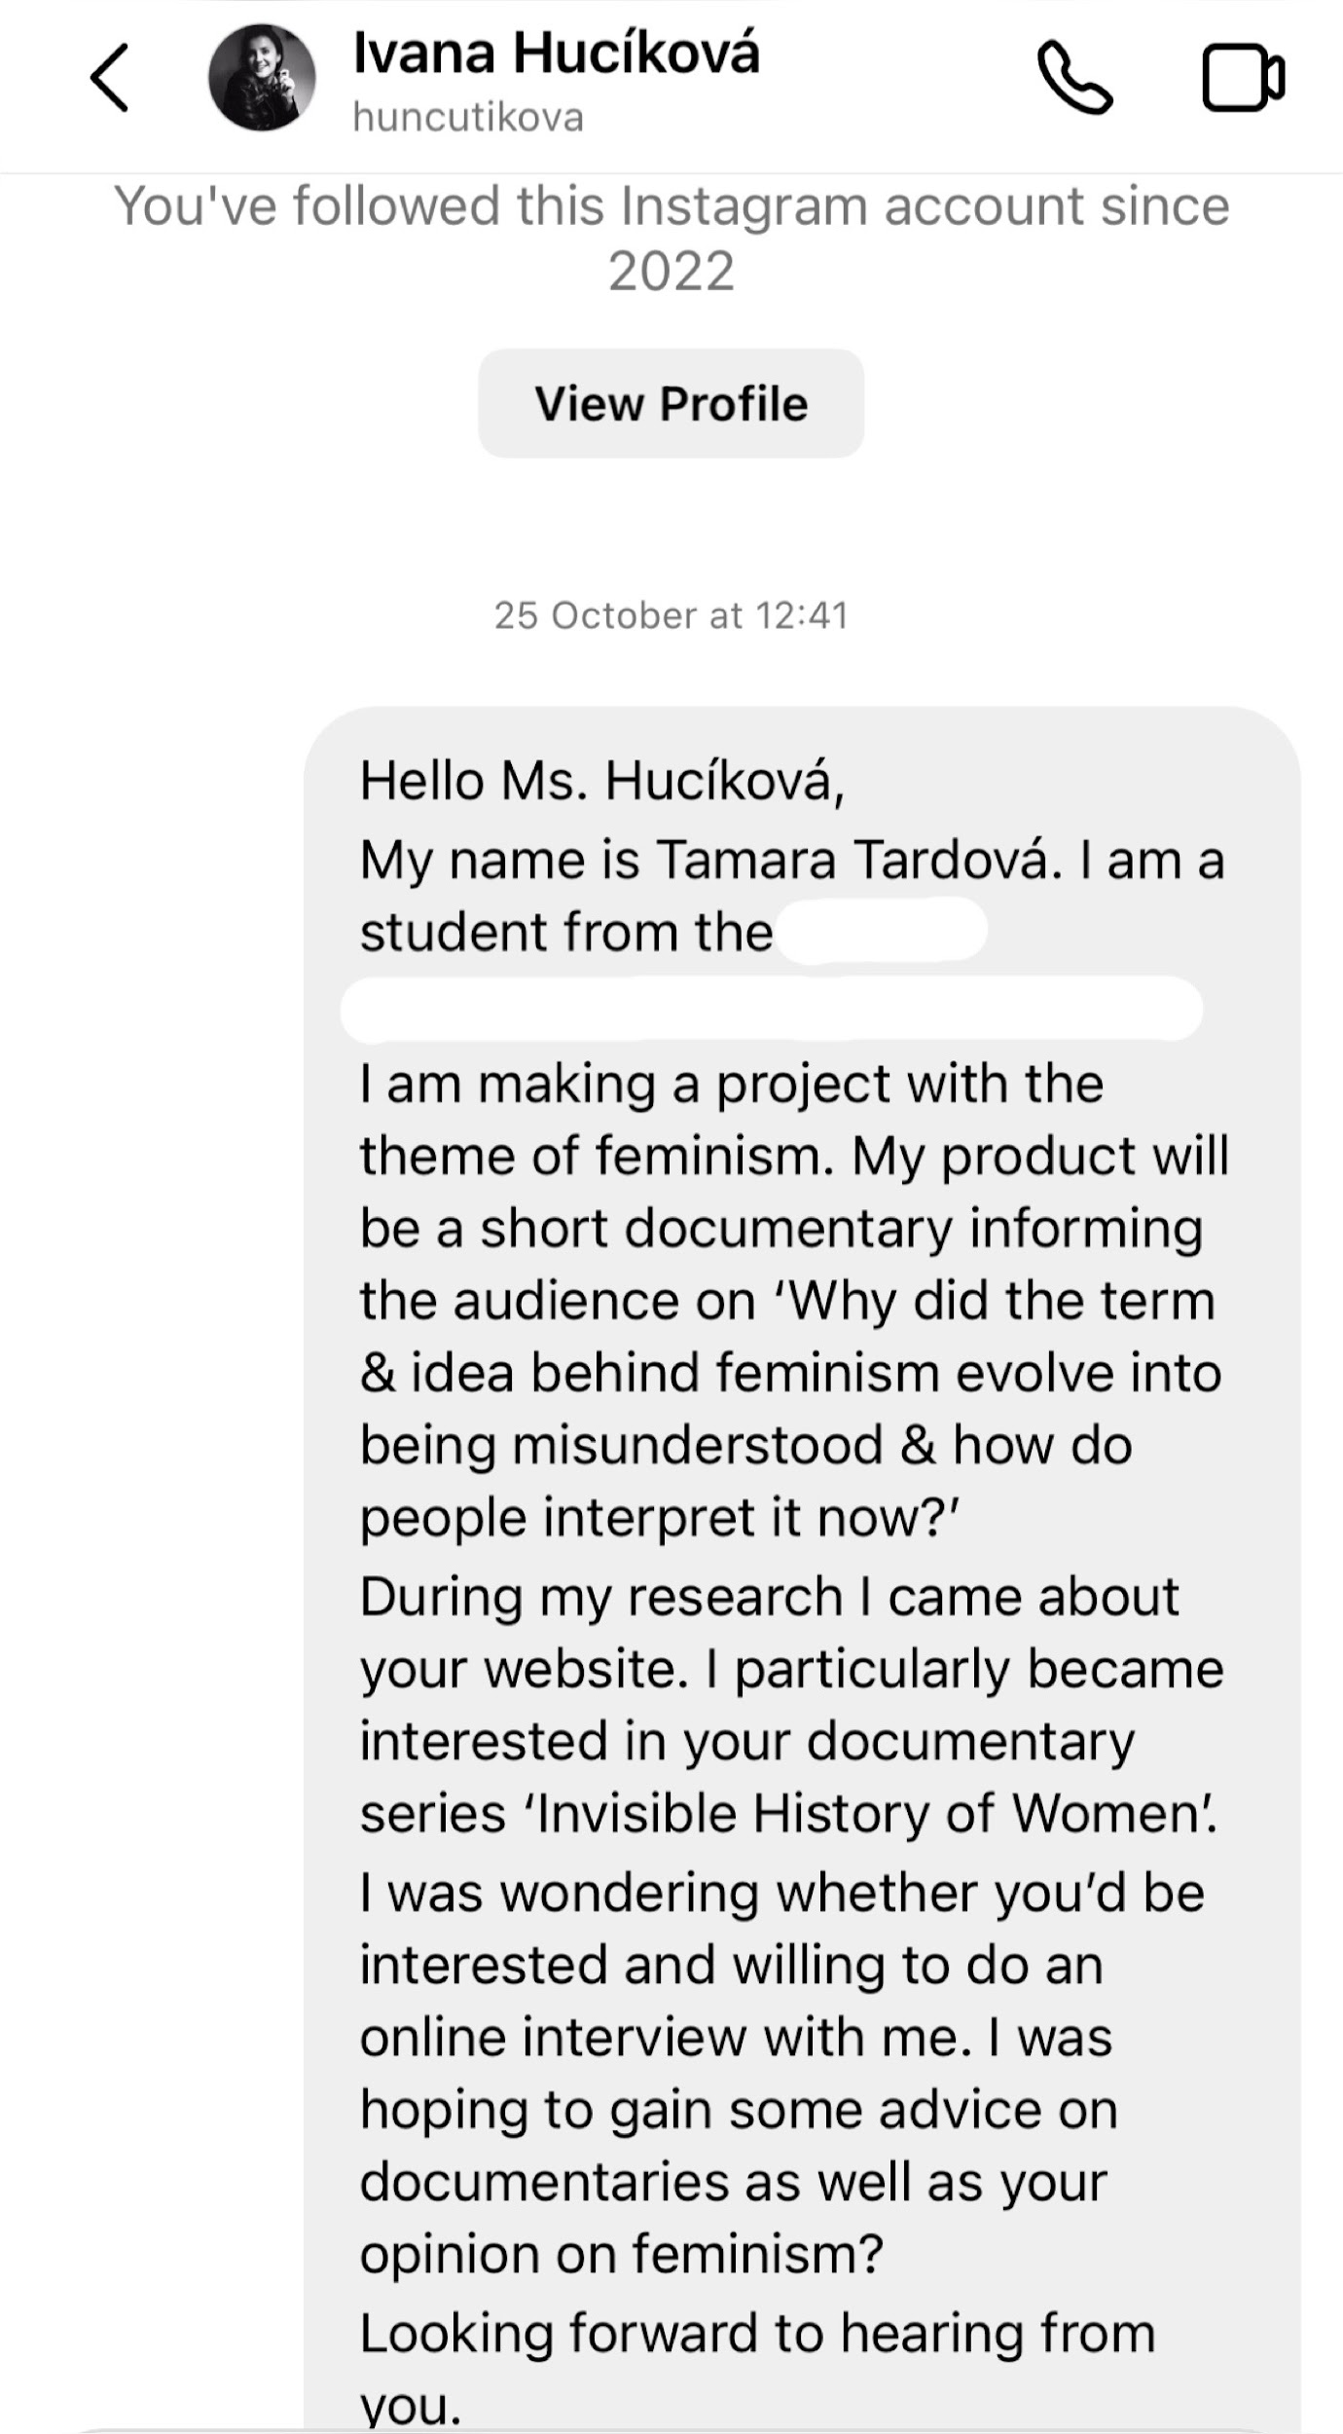
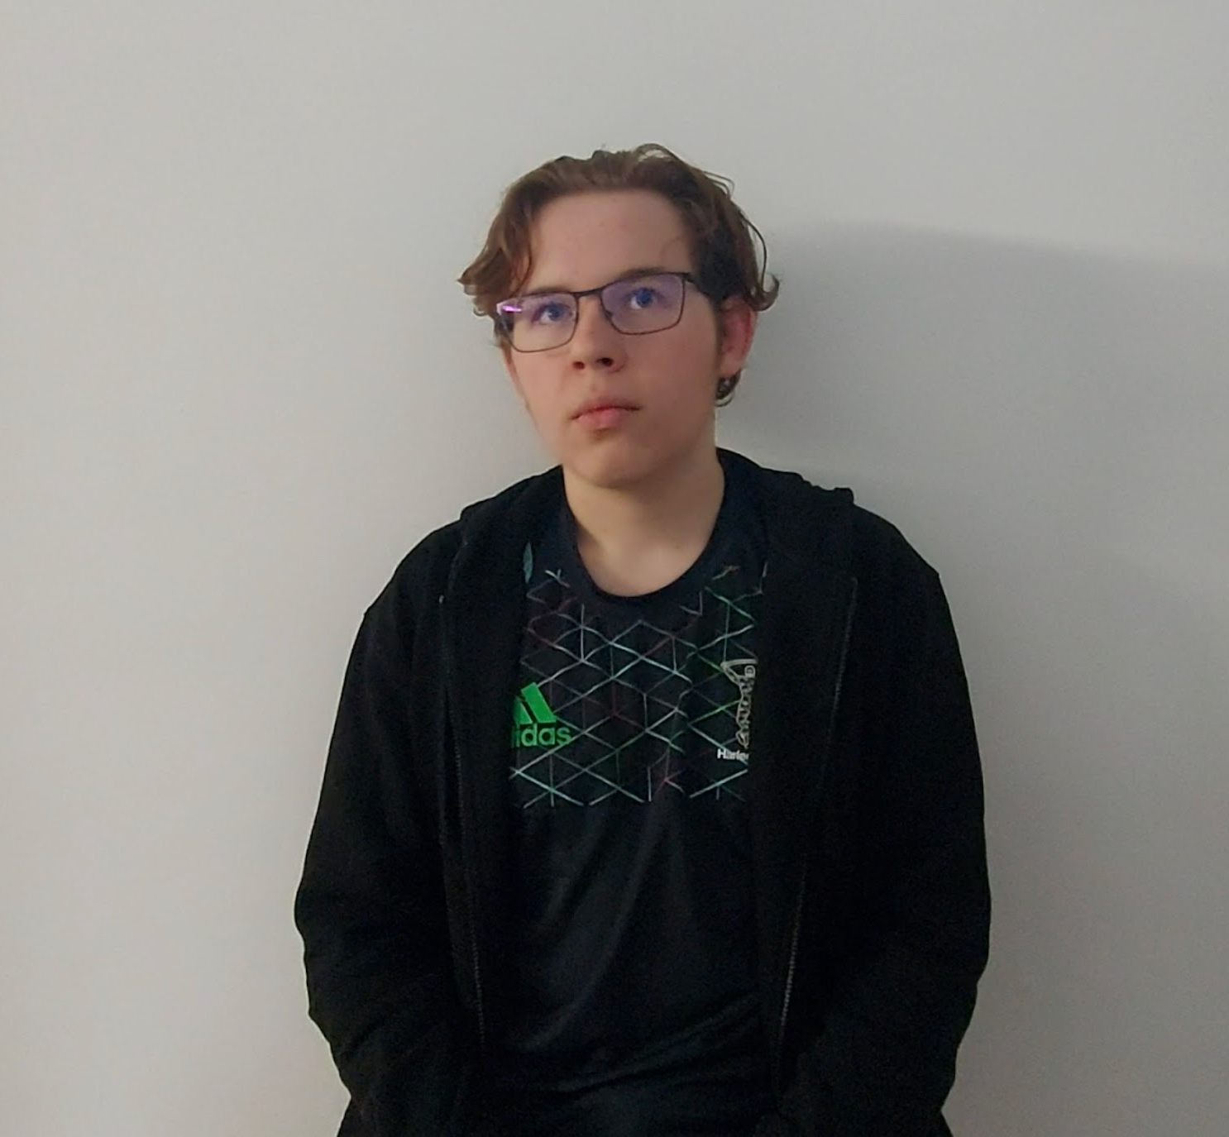
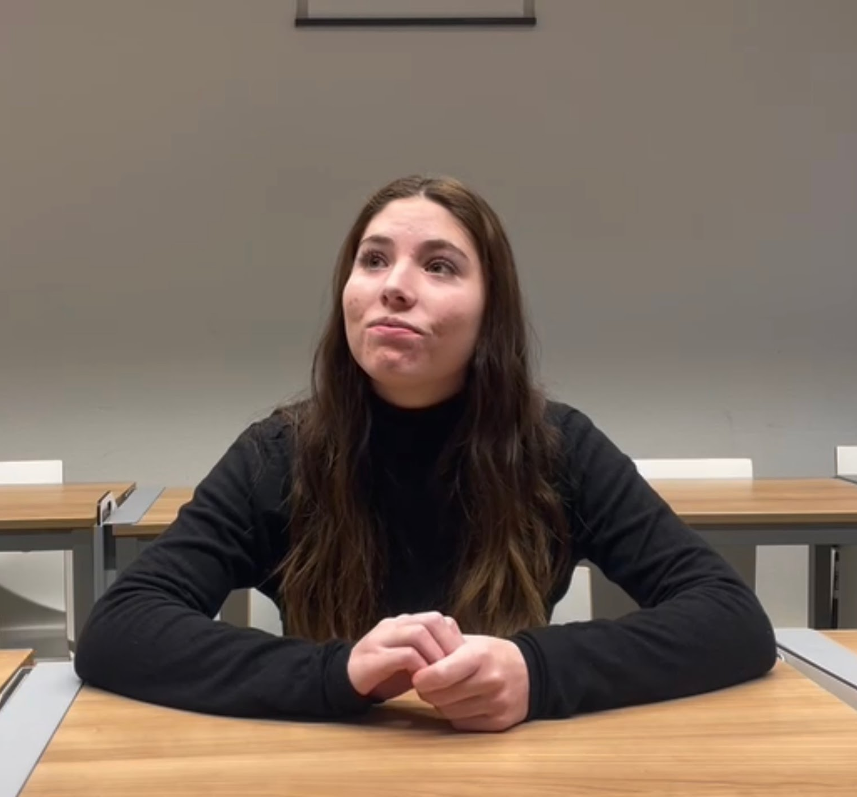
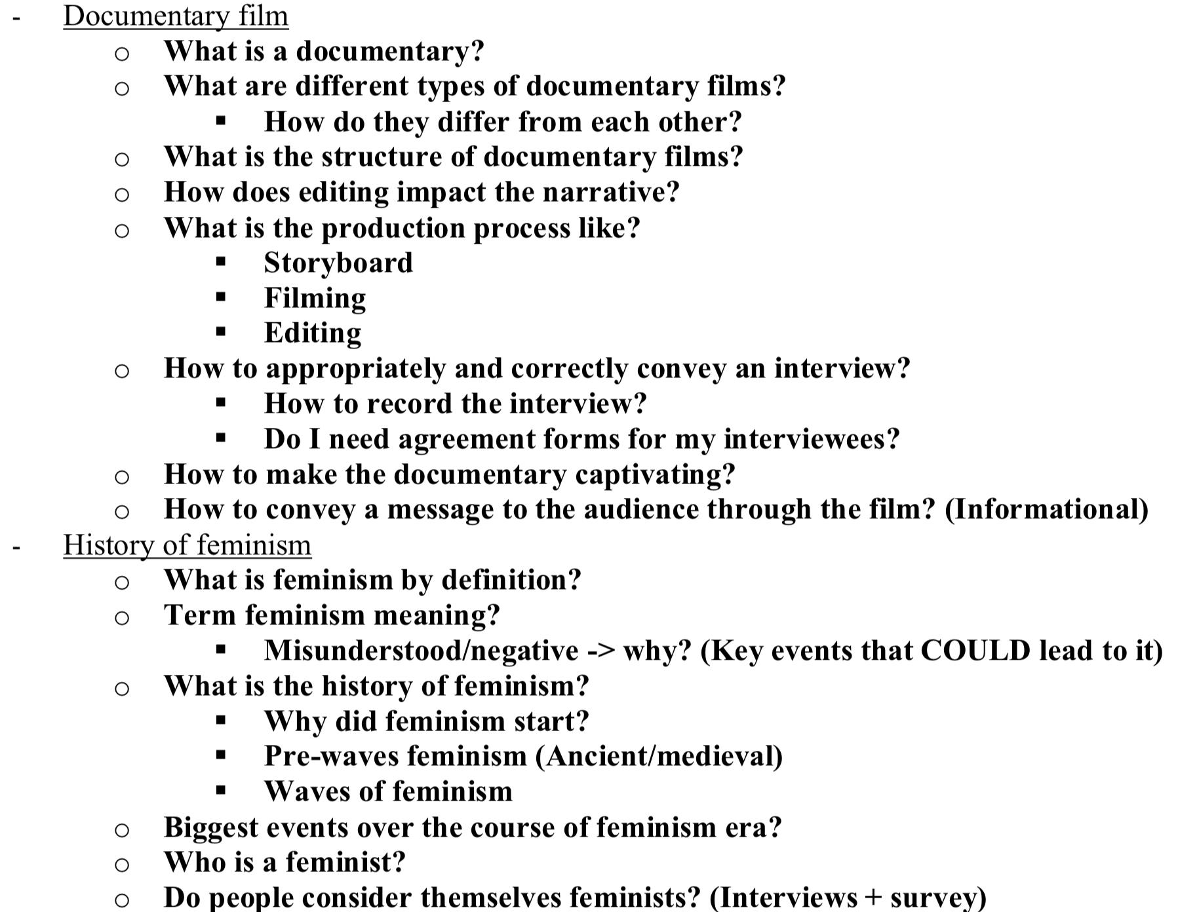
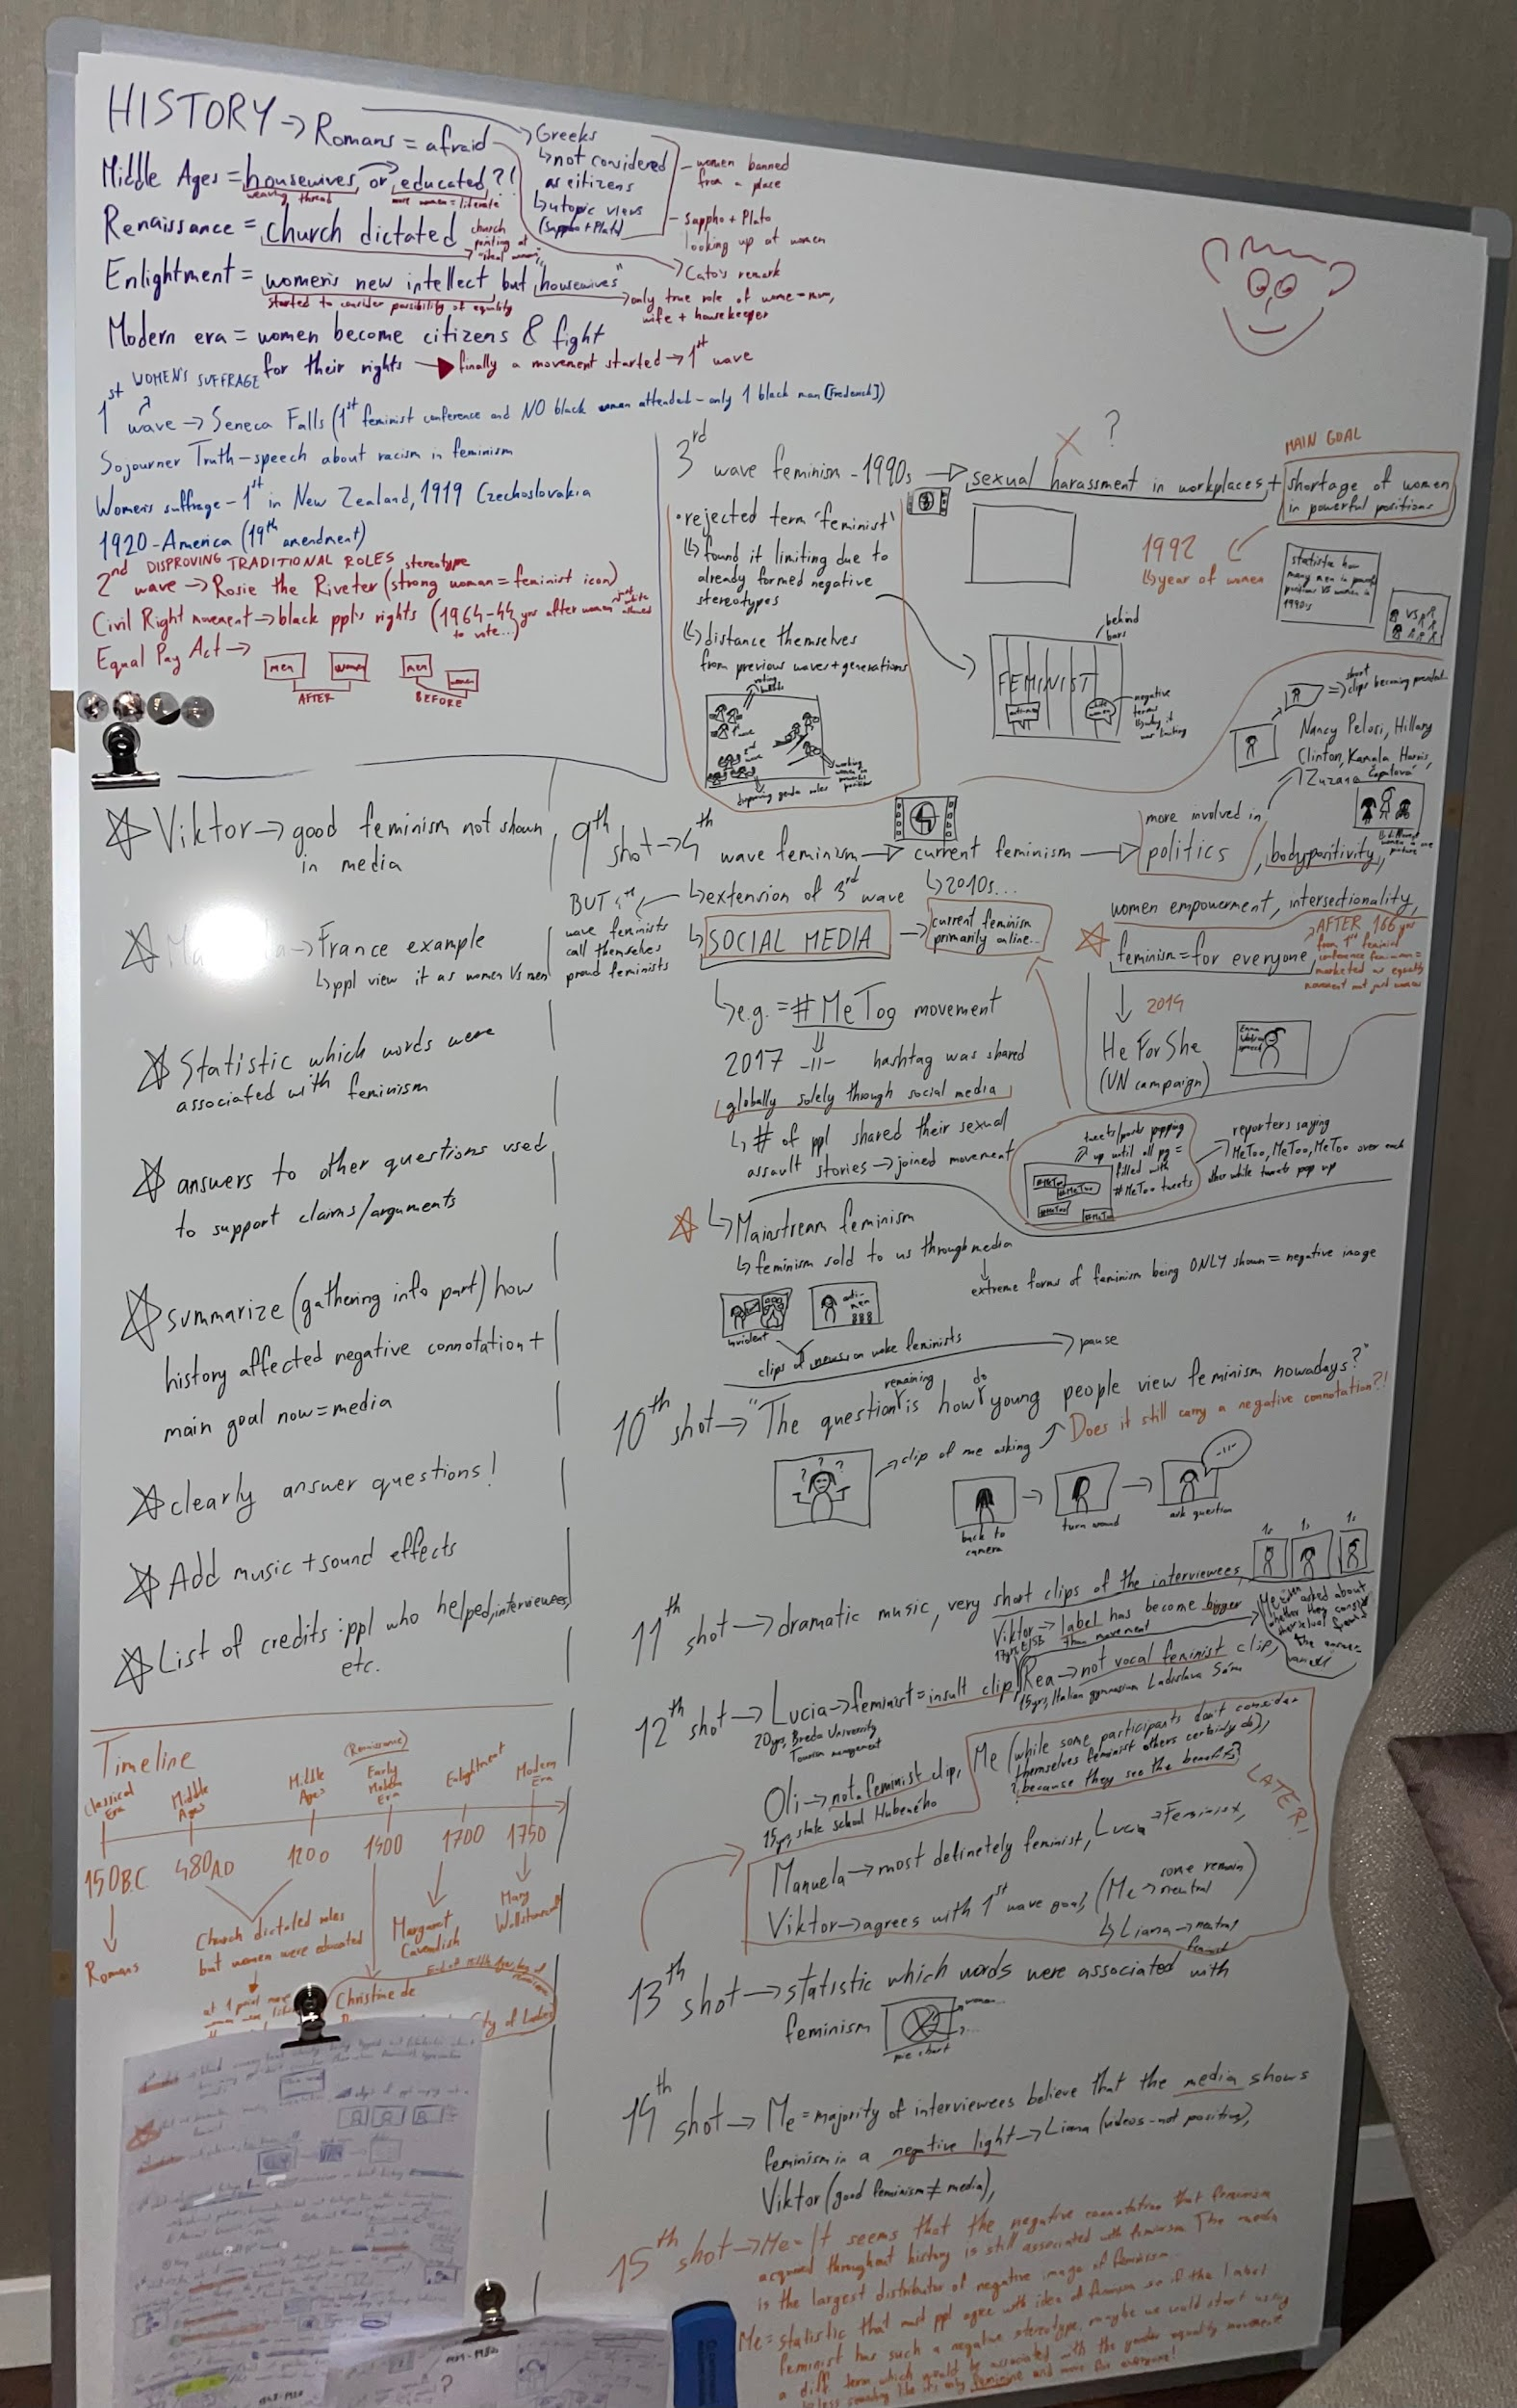
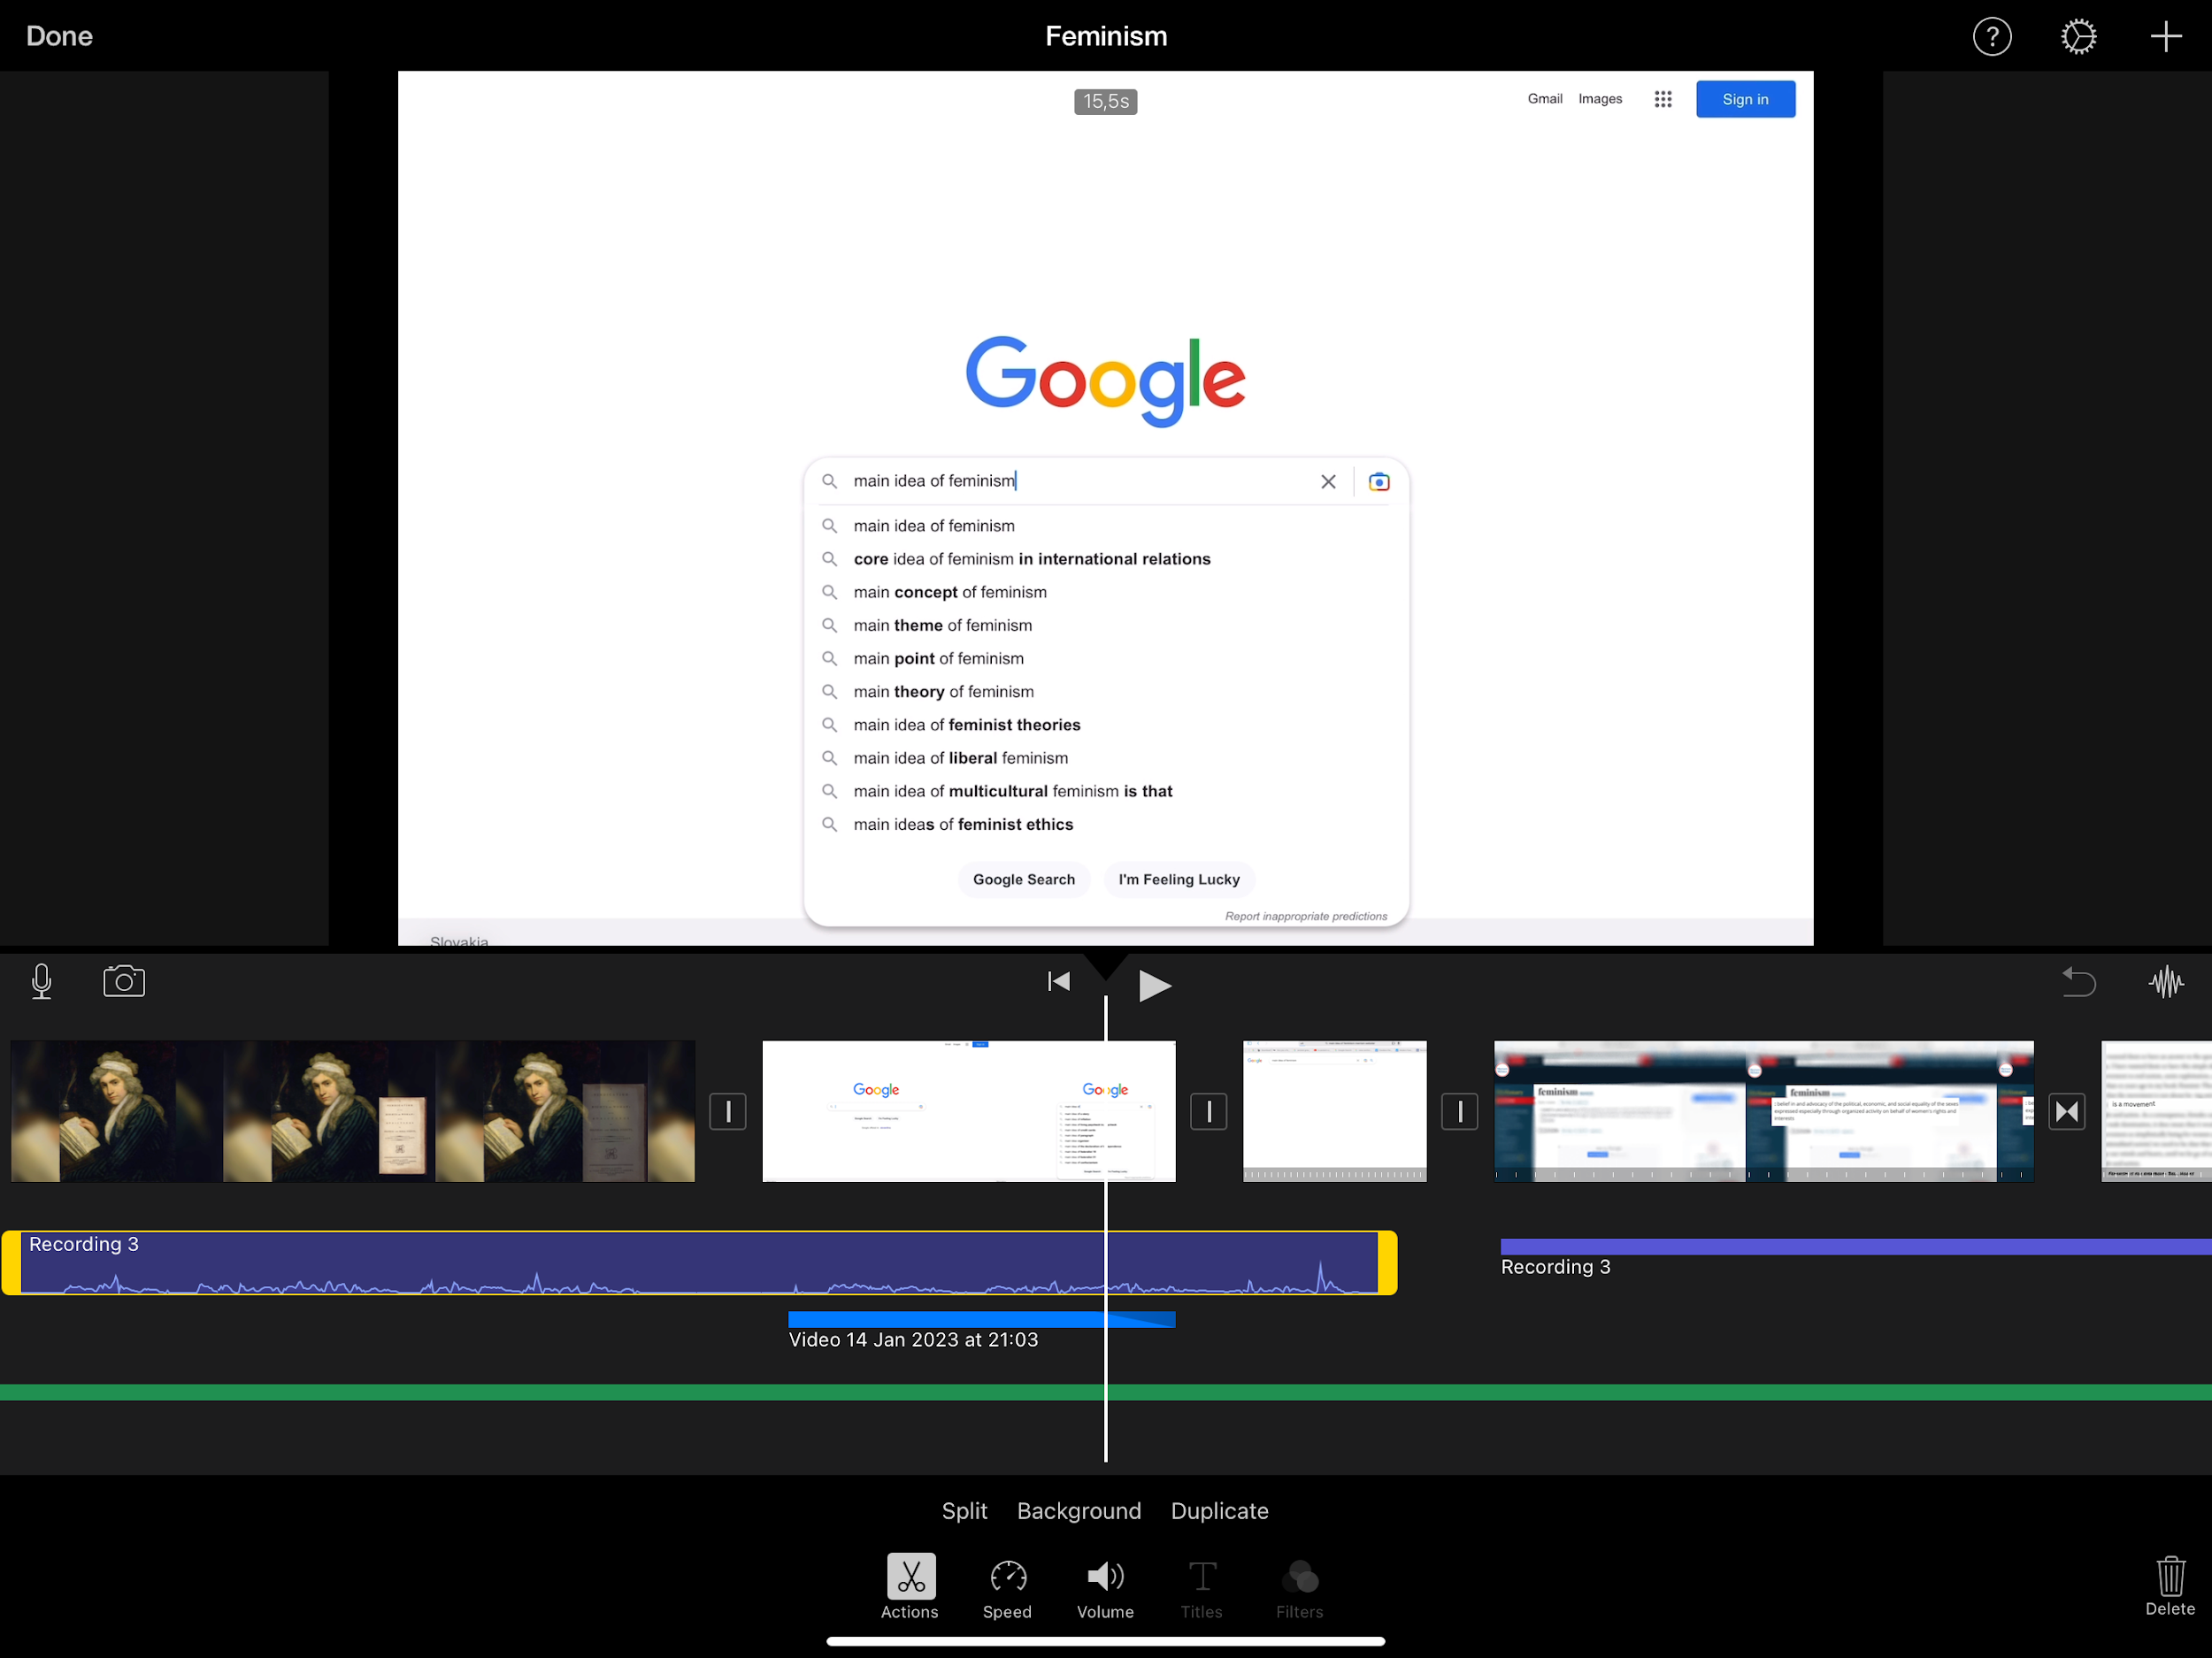
Process
Interviews
Research
Putting everything together
Planning
Editing

Slide 7
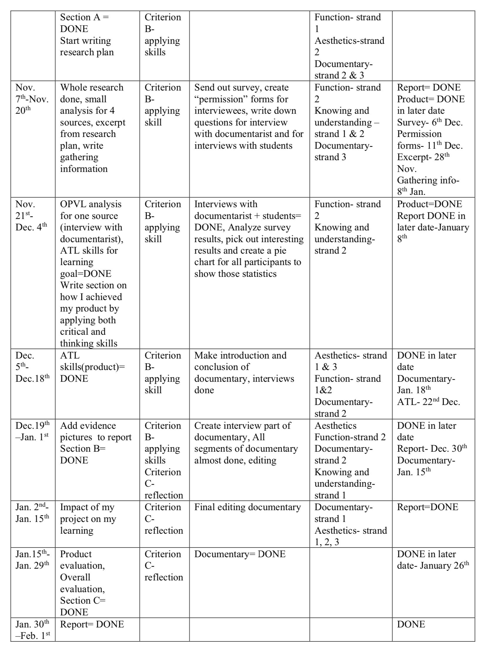
Biggest challenges
Time management
Clear idea of end result

Slide 8
How successful was it?
1
Report
90 %
I finished the whole report and I feel satisfied with how it turned out
2
Documentary
75 %
Some cuts, sound effects, etc. weren’t the best
3
Audience
100 %
100% of the people asked said they liked my documentary

Slide 9
Thank you for listening!
Any questions/feedback?

