Slide 1
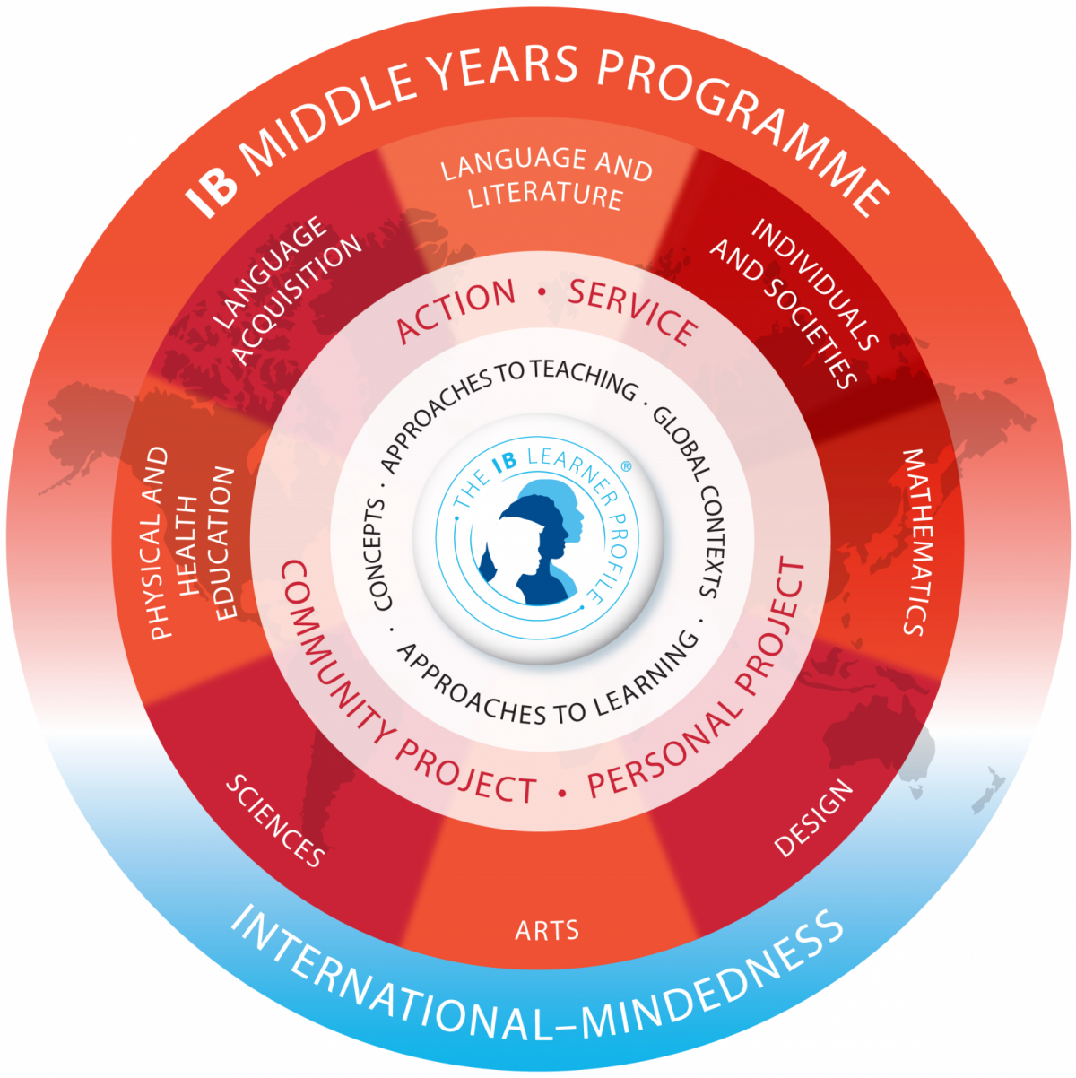
The IB Middle Years ProgramME (MYP)
An Introduction

Slide 2
The Middle years programME
5-year program (MYP1-5, corresponding with our Y7-11)
8 subject areas, all equally important
NOT a prescribed curriculum (no specific books, topics, units, etc.)
Curriculum framework - Provides schools with concepts/contexts around which they can build curriculum
Encourages critical thinking, inquiry, flexibility, international-mindedness
MYP 5 students complete a Personal Project, showcasing their growth and independence as learners
Notes:
(For specific subject areas, see the diagram on the cover slide.) The IB sees all subjects as important and necessary in creating a well-rounded student. Therefore, PHE, Design, and the Arts are on equal footing with math, science, etc. This program is not meant to be about memorization, rote learning, etc., but rather about giving students the tools to think for themselves.

Slide 3
Approaches to learning (Learning how to Learn)
A set of universal skills useful in every subject, and both in and out of school:
Communication
Social (collaboration)
Self-management (organization, affective skills, reflection)
Research (information and media literacy)
Thinking (critical and creative thinking, transfer skills)
Notes:
EISB has its own set of skills; we are working on meshing them with the MYP system.

Slide 4
IB learner profile (Developing the Whole Student)
IB students strive to be:
Inquirers
Knowledgeable
Thinkers
Communicators
Principled
Open-minded
Caring
Risk-takers
Balanced
Reflective
Students are asked to reflect on their growth in these attributes throughout their MYP experience.

Slide 5
Service And action (An MYP Requirement)
SERVICE
Doing something for the common good
Doing something for the community
Building links with people or groups
ACTION
Learning by doing
Developing responsibility and sense of self
Undertaking new challenges
Notes:
Examples:
Service: teaching someone a new language, helping with school events Action: learning a new language or other skill outside of school, education yourself about global issues and what you can do about them

Slide 6
Grading in the MYP
Each subject has four unique criteria
Students are graded based only on these criteria (no points for HW, behavior, etc.)
Formative and summative assessments Formative: practice, training for the summative Summative: assessment that will be part of the grade
Final (end-of-year) grade is based on the “trend” of the year; meant to show growth
Notes:
To clarify: the grades are a process, so a first semester grade is not a finished product; there is still more to learn. Any grades before the end of the year are just “snapshots” of where the student is. Grades are not percentages, averages, etc.

Slide 7
Personal project
Independent project in MYP5/Y11
Create a product or outcome based on personal interest and research
Create criteria to measure success of the product
Write report describing process of creation, including research, planning, action, and reflection.
Discuss ATLs and IB learner profile

