Slide 1
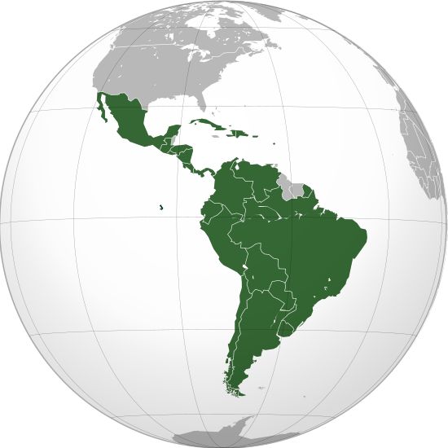
Latin-American Dishes
Made by Viktor MYP1

Slide 2
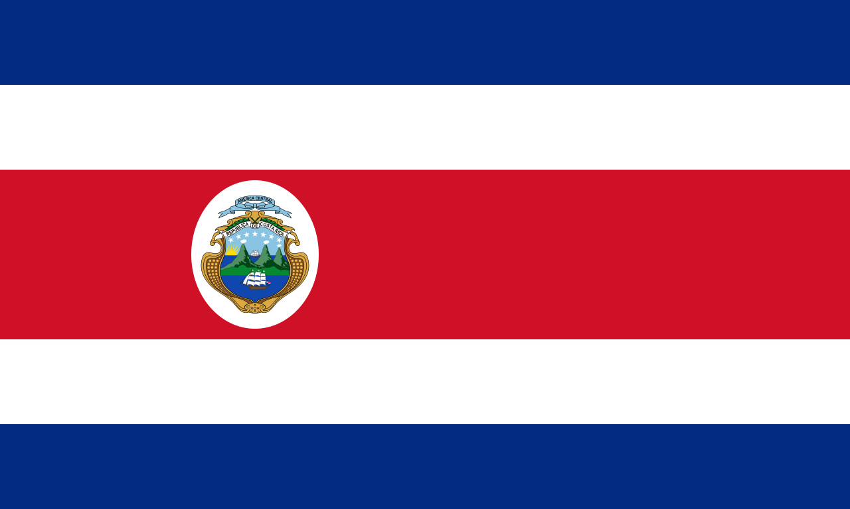
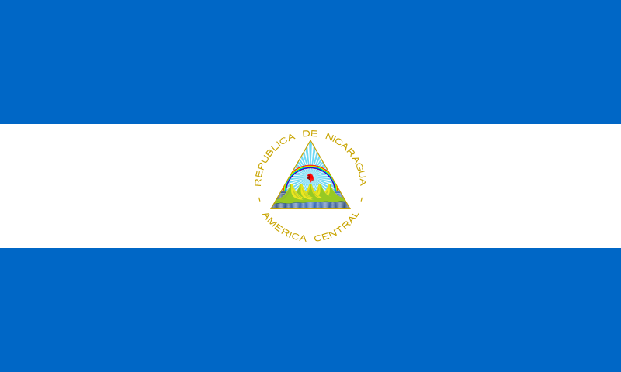
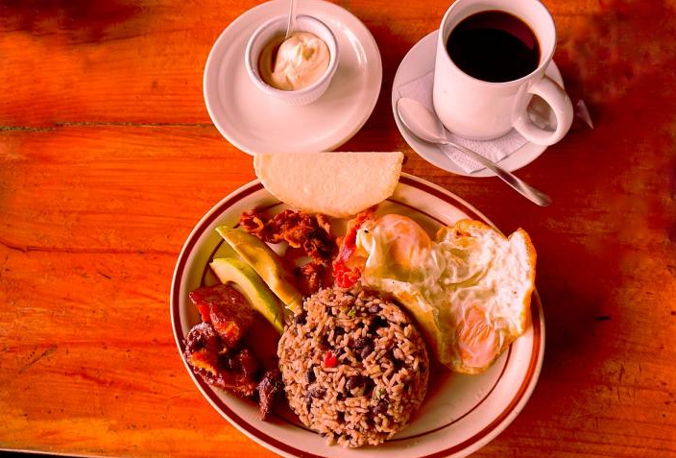
Gallo pinto
Gallo Pinto is originally from or
(Costa Rica) (Nicaragua)
It is uncertain and disputed which country is the precise origin of the dish.
Both Costa Rica and Nicaragua claim it.
Some basic information:
The beans in gallo pinto are quickly cooked until the juice is almost consumed, then combined with prepared rice and other ingredients such as cooked bell peppers, chopped onions, and garlic.

Slide 3
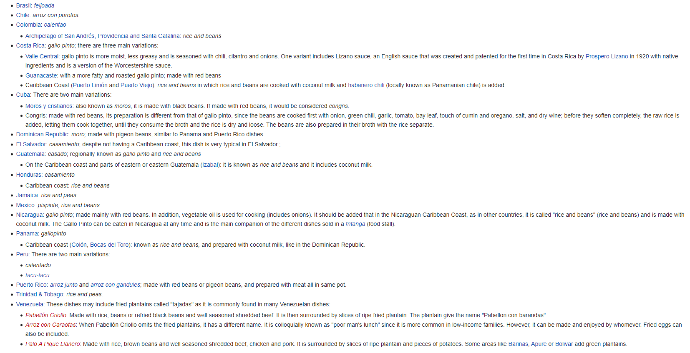
Forms and variations of
Gallo Pinto
In the Americas, there are many dishes with a base of beans and rice, which vary in their cooking and additional ingredients. Variations exist regionally, as cultures shape the dishes to their own preferences. In countries near or in the Caribbean, these dishes are simply known as rice and beans, in which the dish is cooked in coconut milk. Variations of gallo pinto are the following:
As you can see, there are a lot of them.

Slide 4
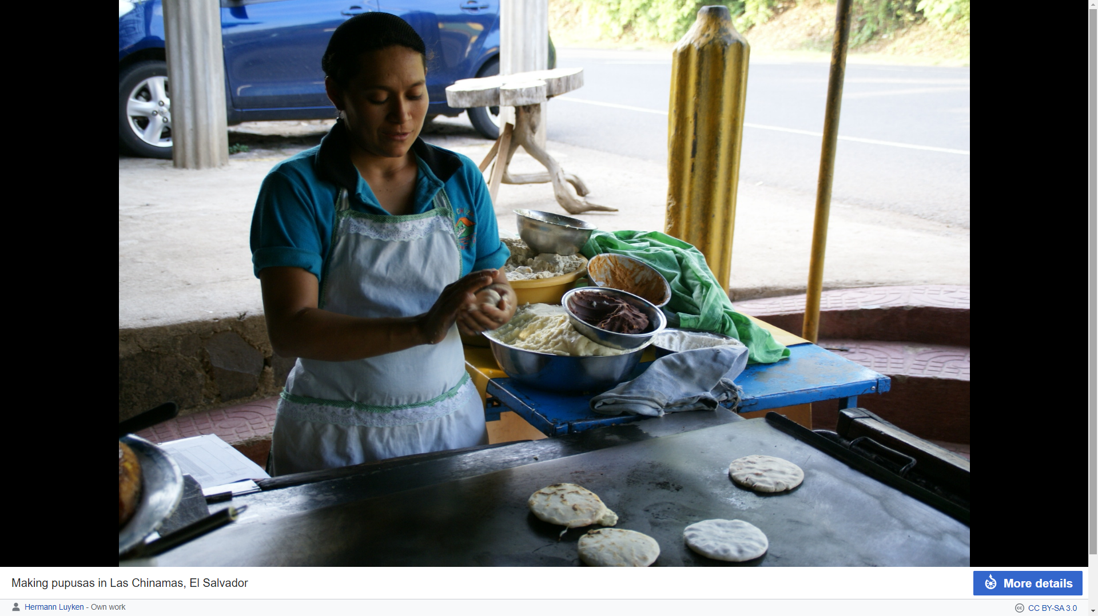
Pupusa
Pupusa : A salvadorian dish, if not variated, in such ingredients:
Made from masa dough, the base for tortillas, tamales and other Latin cooking staples, pupusas are thick corn cakes filled with a variety of ingredients such as pork, chicken, cheese or beans. For certain, they are always served with curtido, a wonderfully crunchy and tangy cabbage slaw, and a simple red salsa.
Pupusas have been linked to the Pipil tribes who inhabited the territory now known as El Salvador.

Slide 5
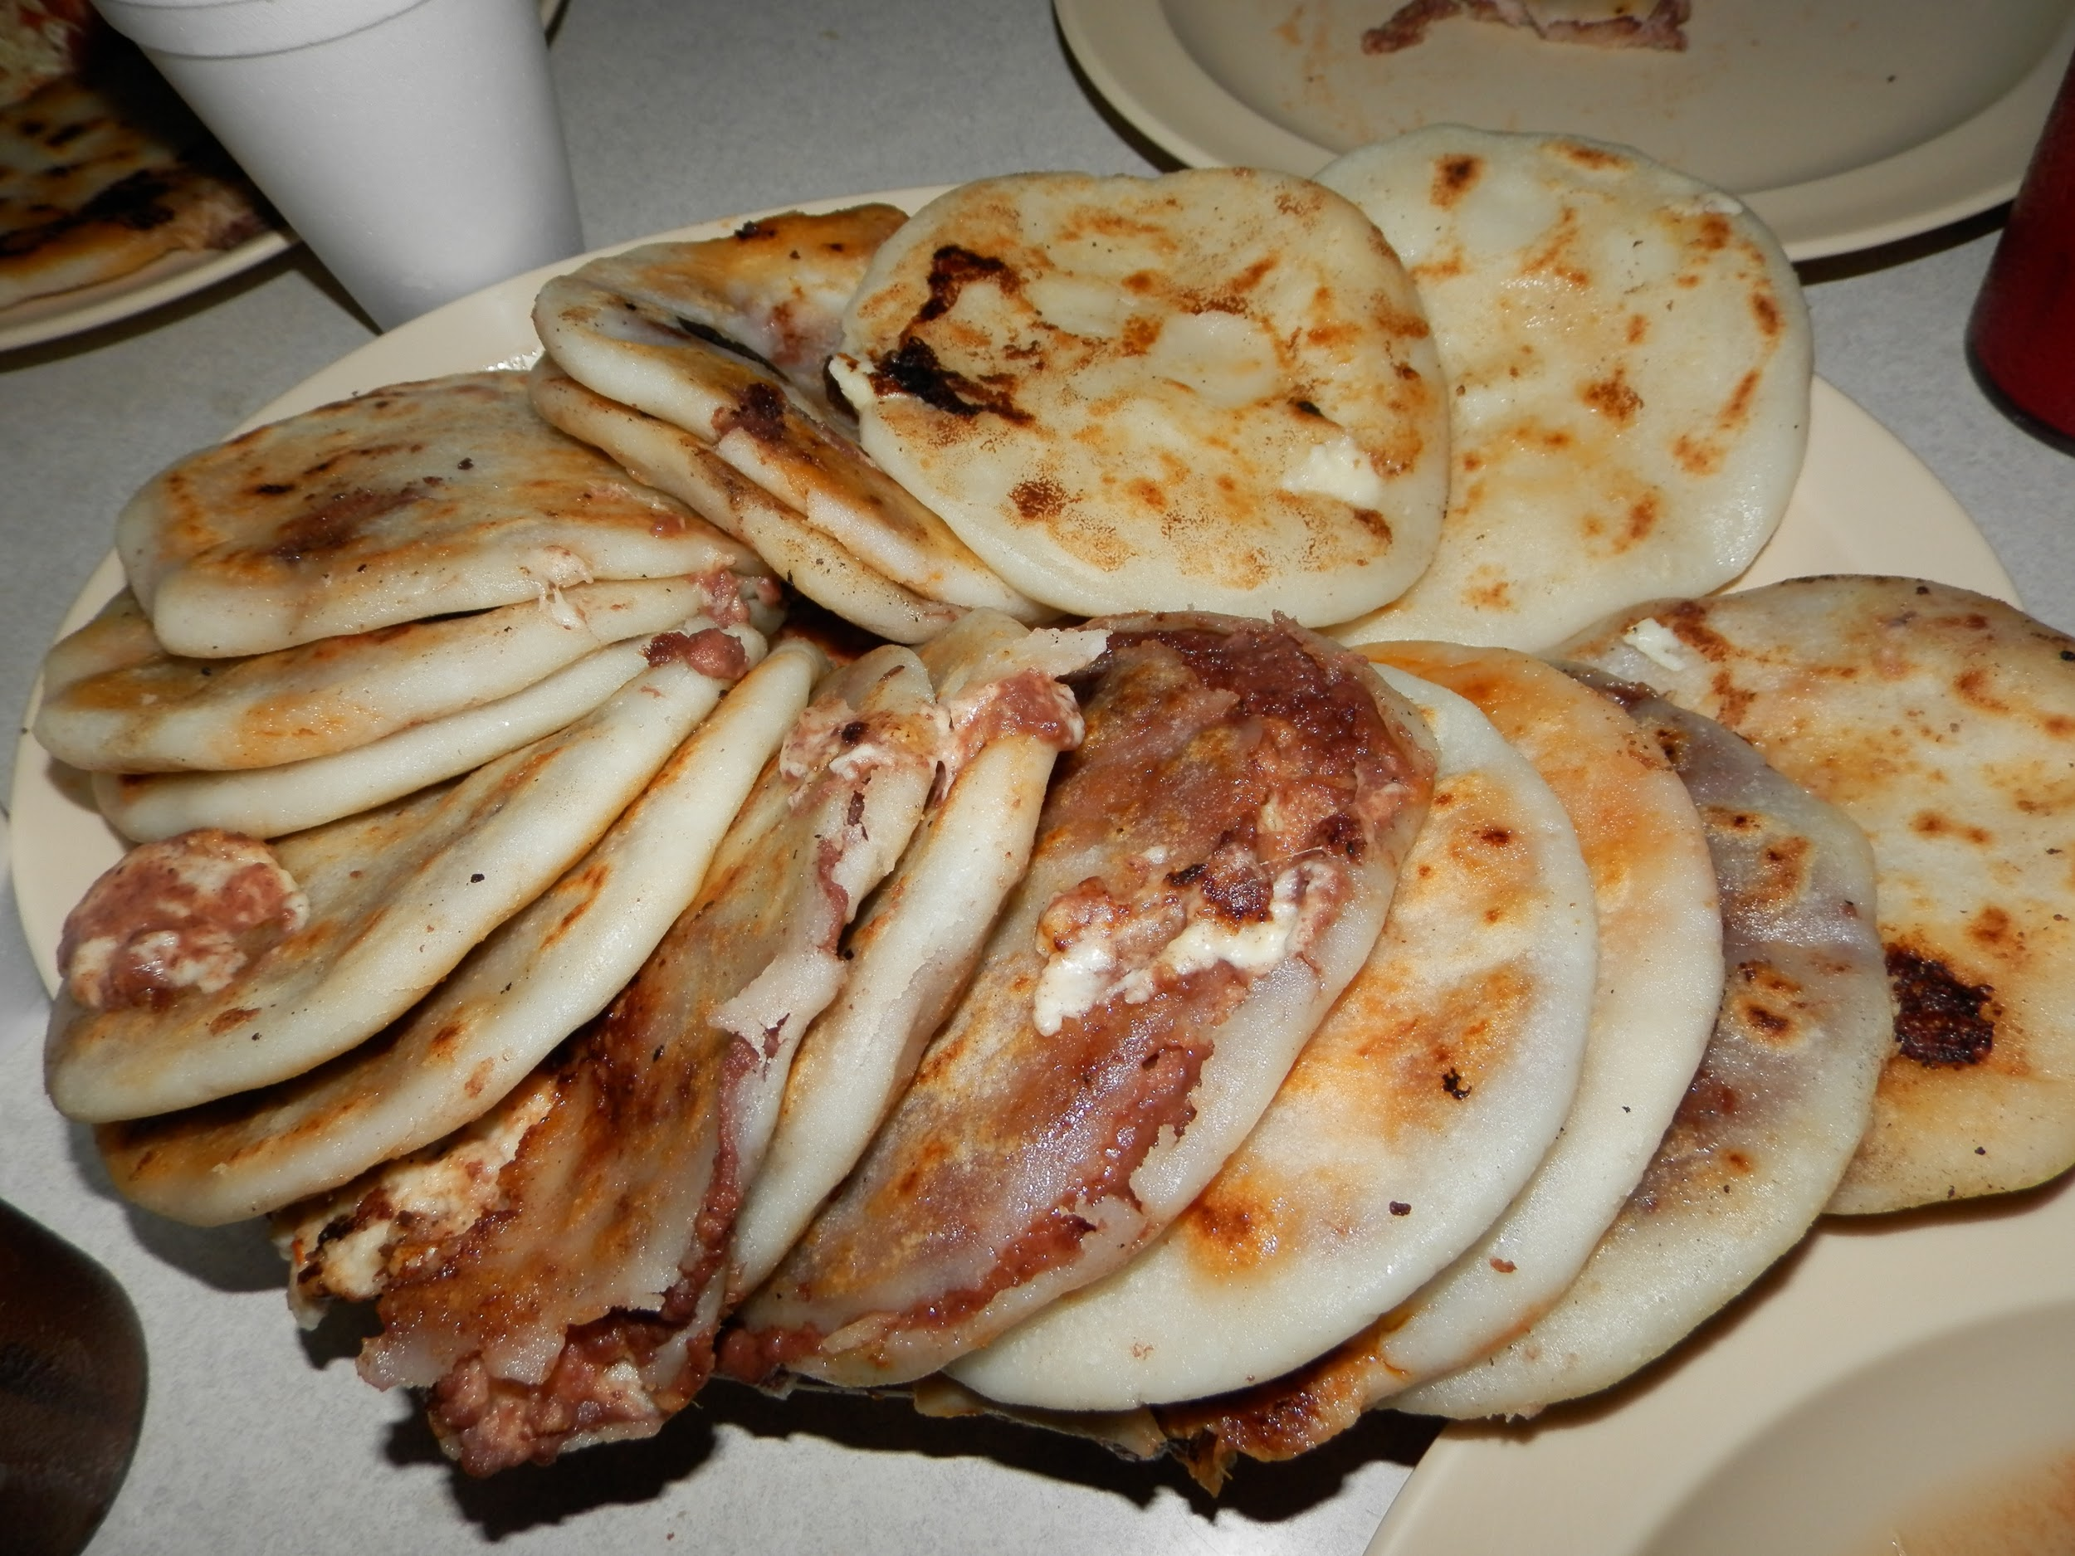
Forms and variations of Pupusas
Usually, the principal types of pupusas are:
cheese (pupusa de queso)
refried beans (pupusa de frijoles refritos)
beans and cheese (pupusa de frijoles and queso)
with “loroco” (pupusa con loroco),
very finely ground pork (chicharron),
and a mixture of beans, cheese, and pork (pupusa revuelta)

Slide 6
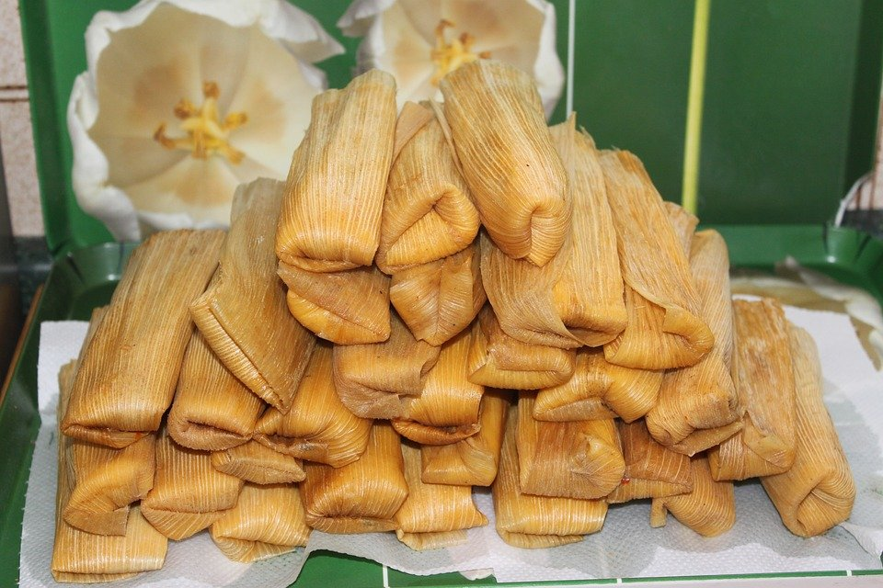
Tamales
Tamales, a mexican dish, made from:
Masa or dough (starchy, and usually corn-based), which is steamed in a corn husk or banana leaf.
The wrapping can either be discarded prior to eating or used as a plate. Tamales can be filled with meats, cheeses, fruits, vegetables, chilies or any preparation according to taste, and both the filling and the cooking liquid may be seasoned.

Slide 7
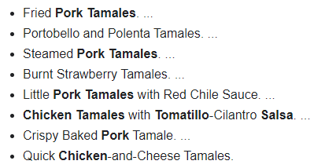
Forms and variations of Tamales
Wow, okay, I didnt know this:
Basically, its hard to describe, because,
“Each region and state has certain types of tamales, so many that the variety is estimated at between 500 and 5,000 throughout the country.”
But, here are some popular (and tasty of course) ones:

Slide 8
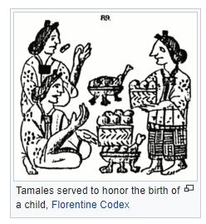
Tamales’ cultural background
Tamales originated in Mesoamerica as early as 8000 to 5000 BC.
The preparation of tamales is likely to have spread from the indigenous culture in Mexico and Guatemala to the rest of Latin America.
According to archaeologists Karl Taube, William Saturn and David Stuart, tamales may date from the year 100 AD. They found pictorial references in the Mural of San Bartolo, in Petén, Guatemala.
The Aztec and Maya civilizations, as well as the Olmec and Toltec before them, used tamales as easily portable food, for hunting trips, and for traveling large distances, as well as supporting their armies.
Tamales were also considered sacred as it is the food of the gods. Aztec, Maya, Olmeca, and Tolteca all considered themselves to be people of corn and so tamales played a large part in their rituals and festivals.

Slide 9
Is there anything I left out?
Please, let me know now.
Do you have any questions?
Are you hungry too???
I am.
Enjoy your fantastic Latin-American food!!!
(for those who are at home and have a flexible menu) 😃👍

Slide 10
Thank you for listening,
I hope you liked it,
Made in 2021 (MYP1 class), Viktor Izák
Subject: Spanish
School: English International School
City: Bratislava,
Country: Slovak republic

