Slide 1
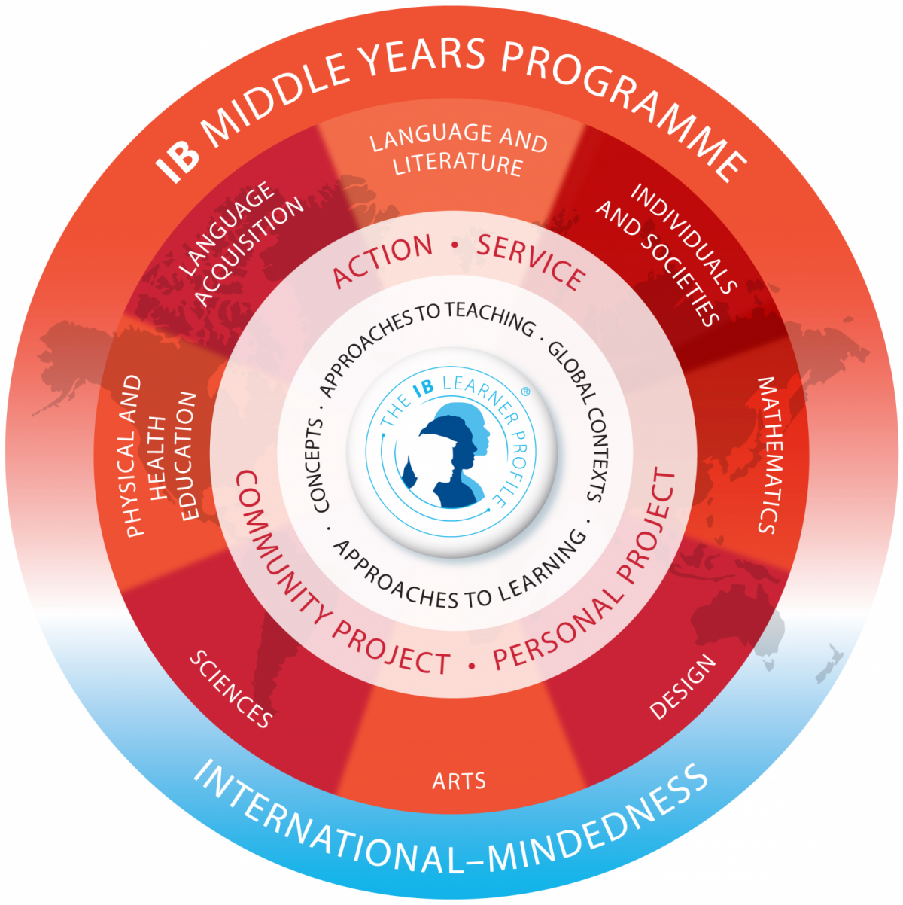
The IB Middle Years ProgramME (MYP)
Grading and Reporting

Slide 2
The Middle years programME
8 subject areas, all equally important
NOT a prescribed curriculum (no specific books, topics, units, etc.)
Curriculum framework - Provides schools with concepts/contexts around which they can build curriculum
Encourages critical thinking, inquiry, flexibility, international-mindedness
Notes:
The IB sees all subjects as important and necessary in creating a well-rounded student. This is why PE, Design, and the Arts are on equal footing with math, science, etc.

Slide 3
MYP Grading in Theory
NOT an average, percentage, or other mathematical calculation
Meant to show growth (process, not product)
No comparisons to other students or “norms”
Teachers follow trend of grades, use “best fit”
Not personal (no points for HW, behavior, extra credit, etc.)
Notes:
To clarify: the grades are a process, so a first semester grade is not a finished product; there is still more to learn. Any grades before the end of the year are just “snapshots” of where the student is.

Slide 4
MYP Grading in Practice
4 criteria, specific to each subject (example to follow)
Each criterion contains “strands” (details, parts); must be assessed at least twice per year
8 points each, for total of 32
grade boundaries used to determine 1-7 report card grade
Formative and summative assessments Formative: practice, training for the summative Summative: assessment that will be part of the grade
More advanced criteria introduced in MYP 3 and 5

Slide 5
EXAMPLE: Language Acquisition
Achievement level | Criterion A: Listening
0 | You do not reach a standard described by any of the descriptors below.
1 -2 | You identify minimal stated information (facts and/or opinions) in simple authentic texts You identify basic conventions in simple authentic texts You identify basic connections in simple authentic texts
3 -4 | You identify some stated information (facts and/or opinions) in simple authentic texts You identify basic conventions in simple authentic texts You identify basic connections in simple authentic texts
5 -6 | You identify most stated information (facts and/or opinions, and supporting details) in a variety of simple authentic texts You interpret conventions in simple authentic texts You interpret connections in simple authentic texts
7-8 | You identify explicit and implicit information (facts and/or opinions and supporting details) in a wide variety of simple authentic texts You analyse conventions in simple authentic texts You analyse connections in simple authentic texts
Criteria: Listening, Reading, Speaking, Writing
Teachers rewrite criteria to be “task-specific” and/or “kid-friendly”
Marks awarded based on best match to descriptors

Slide 6
Final Criterion Grade
Teachers look at all summative grades.
EXAMPLE:
Criterion A Grades:
5, 6, 7 = 7
7, 6, 5 = 5 (but hopefully, grades don’t go down!)
In cases where a student’s grades don’t follow a simple path, teachers use their best judgement based on both F and S assessments, plus their own observations.
Notes:
Grading like this emphasizes growth, and showing how a student has developed through the course.

Slide 7
Final Report Card Grades
Add up points for all 4 criteria (highest score 32)
Find total in grade boundaries
Only report card grades of 1 or 2 considered failing
Only final (end-of-year) grade counts
(NOTE: Excellent, very good, etc. are NOT official IB language.)
GRADE BOUNDARIES
7 28-32 excellent
6 24-27 very good
5 19-23 good
4 15-18 satisfactory
3 10-14 acceptable
2 6-9 limited (failing)
1 1-5 very limited (failing)
Notes:
In answer to a parent question: when students leave EISB, it usually isn’t necessary to “translate” grades for the news school. Many schools/countries have their own systems, so schools are aware of the differences. Often students will be tested at the new school, and if needed they will contact us for more information. The IB is recognized internationally, so most other schools have at least some knowledge of our program.

